Slide 1
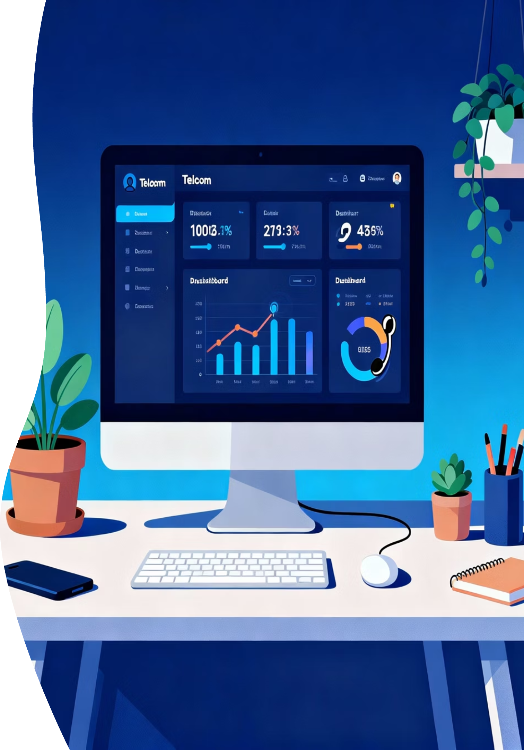
Power BI Data Analysis
Telecom Customer Churn Analysis
Power BI Dashboard Analysis
Uncovering insights from customer behavior patterns through Power BI dashboard development and data analysis.
Presented by:
Saurabh Shirole

Slide 2




About Me
Computer Science Graduate
Saurabh Kailas Shirole
An accomplished professional with expertise in data analysis and a strong foundation in computer science.
Academic Background
Holding a Bachelor of Science in Computer Science, specializing in analytical problem-solving.
Professional Network
Connect with Saurabh on LinkedIn to explore his professional journey and contributions. View LinkedIn Profile
Technical Portfolio
Discover a range of projects and technical skills on Saurabh's GitHub repository. Explore GitHub Repository

Slide 3
Problem Statement: High Customer Churn
The Cost of Churn
1
Telecom companies face persistently high customer churn rates, which directly impacts profitability.
Retention vs. Acquisition
2
Retaining existing customers is significantly more cost-effective than acquiring new ones.
Project Goal
3
Uncover the key, data-driven reasons behind customer churn using Power BI analytics.
Goal: Identify what drives customers to discontinue their service.

Slide 4
Dataset Overview
The analysis is built upon a robust dataset sourced from Kaggle, providing detailed customer information.
Key Columns
Gender, Senior Citizen, Partner,
Dependents
Source
Kaggle – Telecom Customer Churn Dataset
Tenure, Contract, Monthly Charges
Internet Service, Tech Support, etc.
Records
~7,000 customers
Target Variable
Churn (Yes/No)
The dataset includes both demographic and service-level details, crucial for comprehensive analysis.

Slide 5




Color Palette
Pink: Female Ratio
Blue: Male Ratio
Represents the proportion of female customers in the data analysis.
Indicates the proportion of male customers within the datasets.
Cyan: General Graphs
Paperless Billing Data:
Yellow : Yes
Purple : No
Applied to visualize general data trends and comparisons across various graphs.
Specifically highlights information pertaining to paperless billing adoption and trends.

Slide 6

Business Objective
Understand the Churn Drivers and Analyze why customers are leaving the telecom company.
Identify the Key Factors Determined that which factors—like contract type, services, or payment methods—affect the churn.
Enable and Actionable Strategies that Help the company take actions to reduce the customer loss and improves the customer satisfaction.

Slide 7
Data Preparation
Dataset Used :
Telecom Customer Churn Data (7,043 records, 21 columns)
Steps Taken
Imported the dataset into Power BI.
Removed duplicates and handled missing values (mainly in TotalCharges).
Converted data types – e.g., SeniorCitizen (0/1 → Yes/No).
Created new columns like:
Tenure (in months )
Number of Services
% of Partners, Dependents, Senior Citizens

Slide 8




Key Visuals
Donut Charts
Bar Charts
Used for Gender Split & Paperless Billing
distribution.
Visualizing Internet Service, Contract Type, Customers years with Company and Payment Methods.
KPI Cards
Multi-Row Card
Quick display of Total Customers,
Churn Customers, Churn Rate, and Averages.
Detailed view of top services used (e.g., Online Backup, Device Protection etc.)

Slide 9
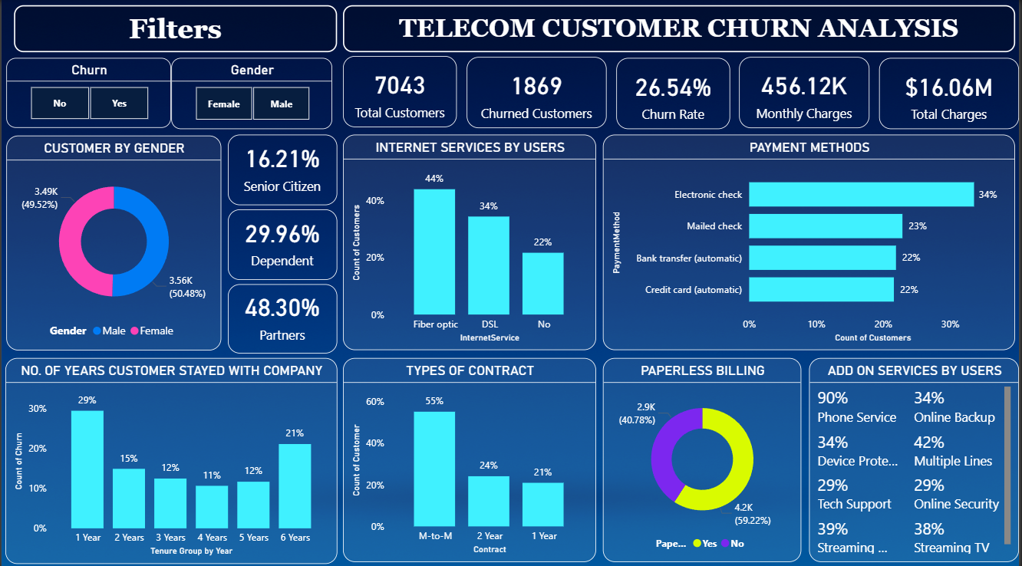
Dashboard Overview
This Power BI dashboard offers a comprehensive visual overview of critical customer churn metrics, trends, and segmentation. It highlights key factors influencing churn, such as service usage, contract details, and demographic information, providing actionable insights for strategic decision-making and retention efforts.

Slide 10

Link To The Dashboard
Click here

Slide 11
Key Findings from the Analysis
1
Contract Type
2
Demographics
3
Service Loyalty
Month-to-month contract customers show the highest churn rates.
Senior citizens exhibit a higher probability of churning.
Customers lacking Online Backup or Tech Support are less loyal.
4
Tenure Effect
5
Pricing Impact
Long-tenure customers consistently demonstrate lower churn rates.
Higher monthly charges are directly correlated with increased churn risk.

Slide 12





Business Recommendations
Actionable strategies derived from the data to enhance customer retention.
Incentivize Long-Term Contracts
Offer discounts or loyalty rewards to encourage contract commitment.
Promote Bundled Plans
Market bundled services (Backup + Security + Tech Support) to increase stickiness.
Implement Prediction Models
Use churn prediction models for early detection of high-risk customers.
Enhance Support Systems
Improve customer support quality and actively solicit feedback.

Slide 13

Thank You
Questions & Discussion Welcome

